Slide 1
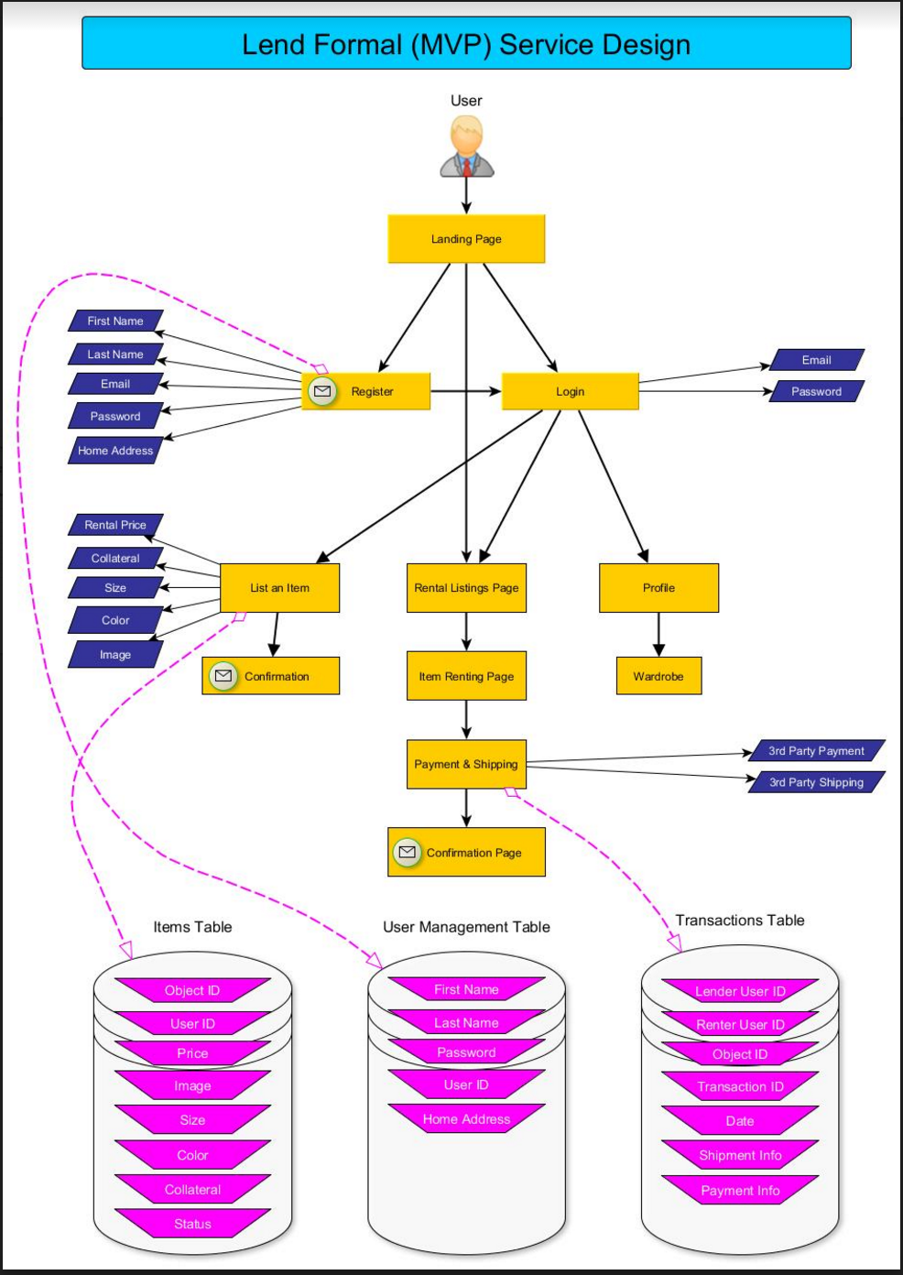
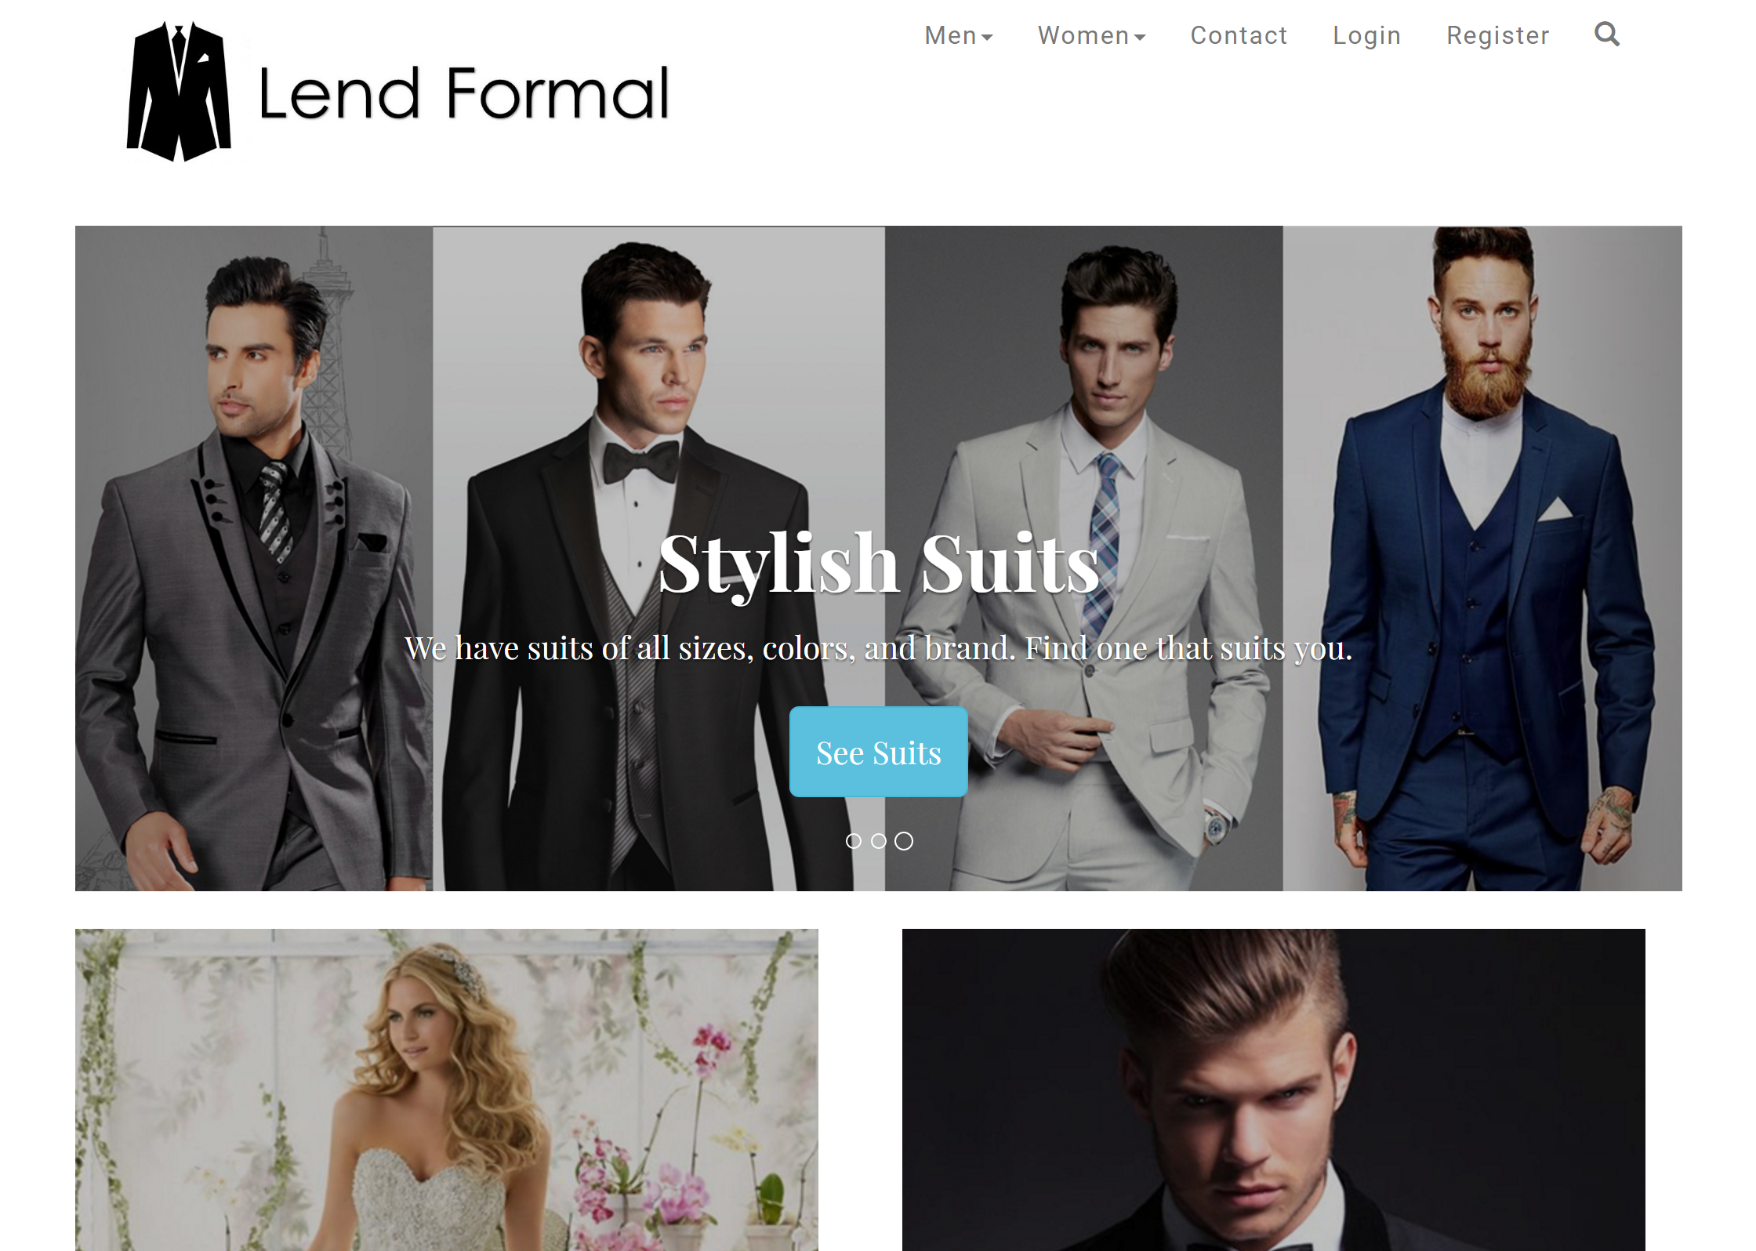
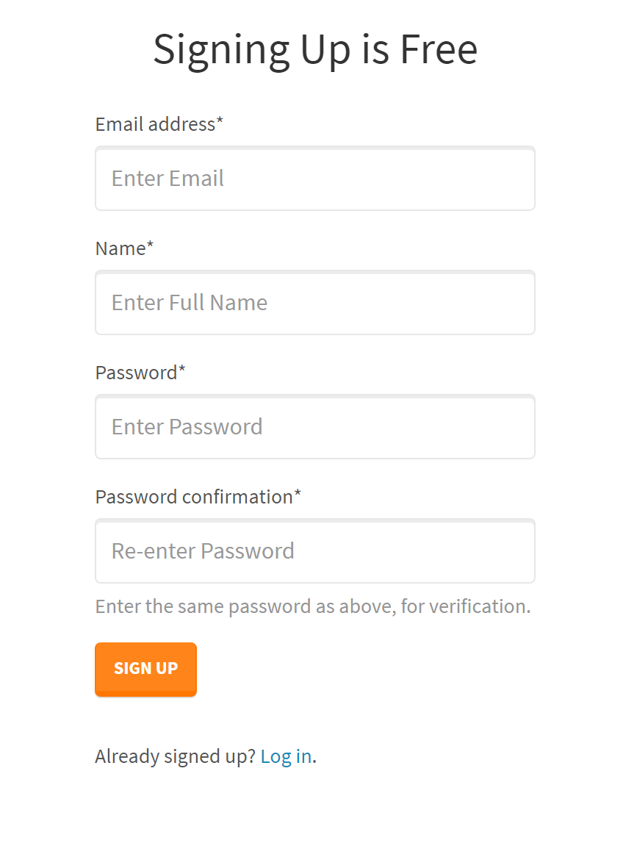
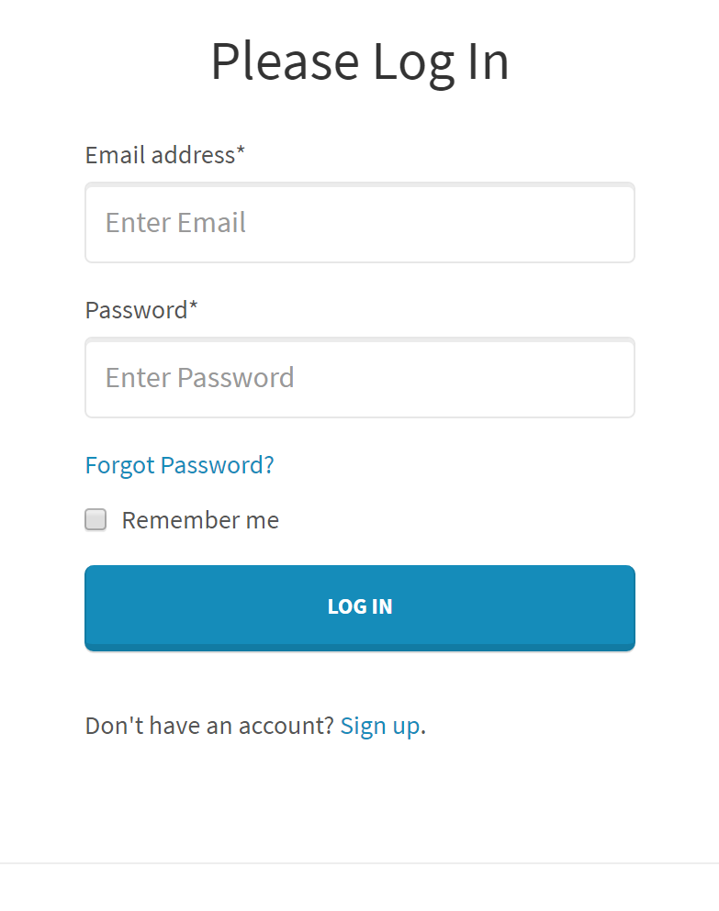
Lend Formal – Project at a Glance
How it Works
Landing Page Design
User Management System

Slide 2
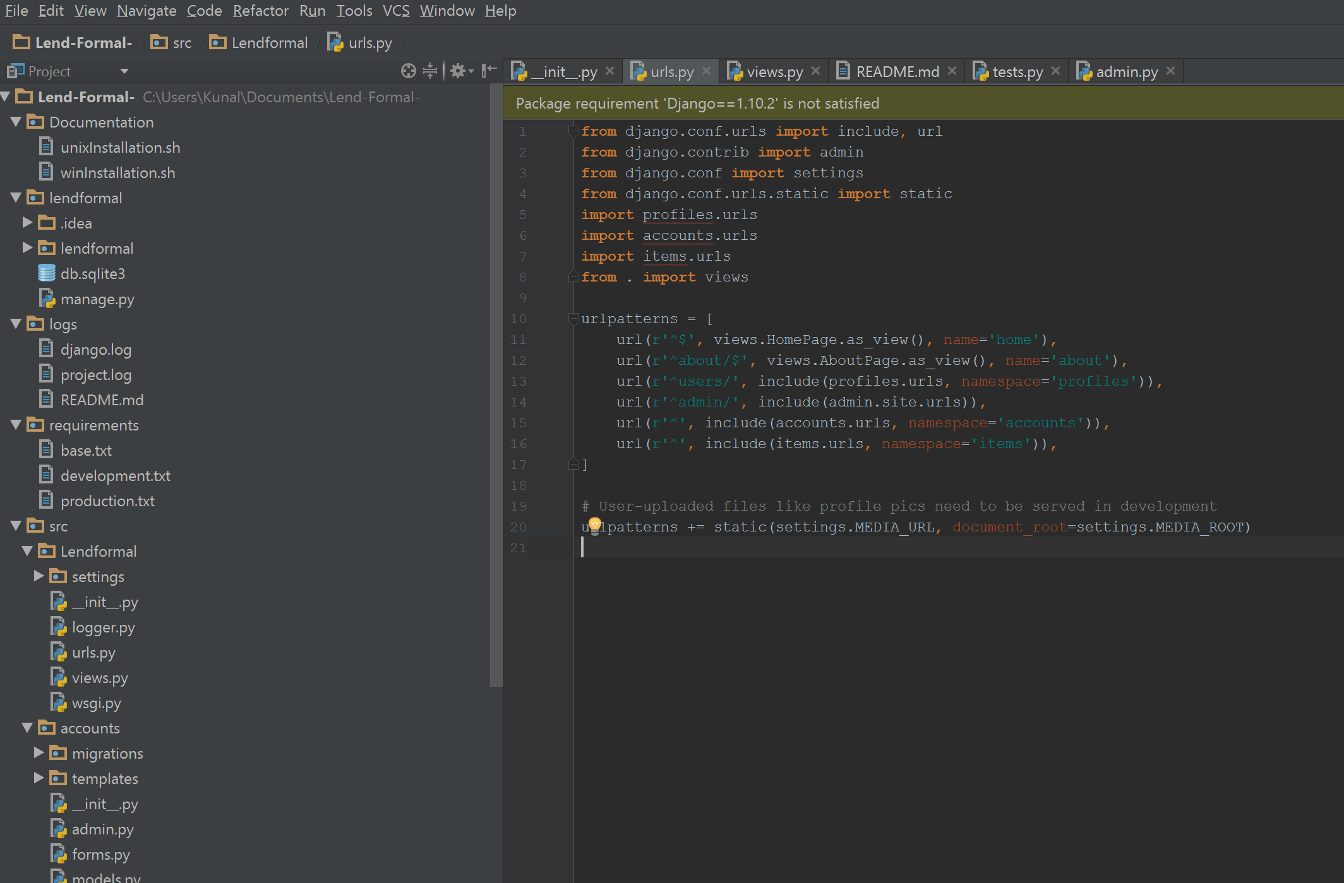
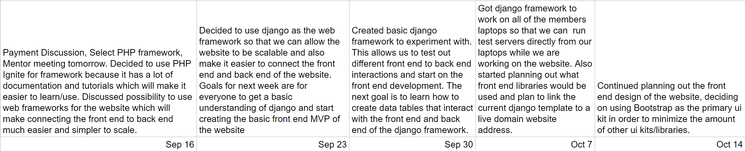
Lend Formal – Behind the Scenes
Created Databases for User Management, Items and Transactions
Created a Web Framework using Python
Learned the Model View Controller Approach to Web Services
Currently Prototyping an Item Listing Page
Learned Front-end UI tools, such as Bootstrap
Held Weekly Meetings, Distributed tasks, Assigned Roles
Django – Python Based Web Framework
Weekly
Progress

